Slide 1
Supervision
Mississippi Board of Examiners for Licensed Professional Counselors
MCA 71st Annual Conference
November 2021
Biloxi, MS

Slide 2
LPC Board Members
Richard Strebeck, PhD, LPC-S, NCC, CSAT, BC-TMH
Chair, Long Beach (District At Large)
Kimberly Elam Sallis, PhD, LPC-S, BC-TMH
Vice-Chair, Oxford (District I)
S. Lynn Etheridge, JD, PhD, LPC-S, RPTS, NCC
Port Gibson, (District II)
Steven Rollins Stafford, MS, LPC-S
Madison (District III)
Issac Boose, MEd, LPC-S
Hattiesburg (District IV)

Slide 3
Objectives
Requirements for Supervisors / Supervision /Supervisees
Requirements for Distance Professional Counseling / Supervisor Service Provider
Supervision Requirements for Telemental Health / Distance Professional Counseling
Ethical Codes Surrounding Telemental Health / Distance Professional Counseling

Slide 4
Supervisor/Supervision Requirements
Supervision Requirements to become a PLPC
Supervision Agreement between Applicant and LPC-S
Supervision Contract between Applicant and LPC-S
Declaration of Practice filed *
Supervisor must be a MS Board Qualified Supervisor
To receive supervision, PLPC can practice in:
A governed by agency
Private practice setting
Notes:
NOTES:
LPC-S must be a Mississippi Board Qualified Supervisor
In a governed by agency, an LPC does not have to be onsite because the agency itself has it’s own Policies and Procedures, oversite committees and credentialing and surveying procedures. They have outside licensure and accreditation
In a private setting, currently, an LPC must be onsite when the PLPC is providing services

Slide 5
Supervision Contract
Brief philosophy of supervision
Context of services
Where supervision will occur
How often for how long
Expectations of the Supervisor
Monitor counseling sessions
Challenge supervisee to justify approach and techniques used
Review progress notes, treatment plans, discharge plans, interventions
Provide sound ethical and professional guidance
Maintain supervision notes
Notes:
Things the Board looks for for approval of the Supervision Contract. Again, there should be no surprises for the supervisee.

Slide 6
Supervision Contract
Expectations of the Supervisee
Uphold ethical guidelines, legal statutes and agency policy
Meet as scheduled with the supervisor
Be prepared to discuss client cases, case notes, treatment plans, video tapes
Consult with Supervisor in cases of emergency
Maintain supervision hours and log and notes
Terms of supervision
Number of hour of counseling to the number of hours of supervision
Fees assessed for supervision
Back-up LPC-S for emergencies or absence of LPC-S
Notes:
In the supervision contract, there must be an LPC-S backup regardless of setting. Policy when the LPC-S is out of the office or unavailable, including a back-up LPC-S Ethics Code: F.4.b. Emergencies and Absences: Supervisors establish and communicate to supervisees procedures for contacting supervisors or, in their absence, alternative on-call supervisors to assist in handling crises. Even though this is not explicitly spelled out in the Rules and Regs, the Board has expectations that all of the licensed counselors in the state of MS will practice ethically. For example, if I have an accident on the coast or on my way back to North MS and I am incapacitated for a few weeks, my supervisee needs to have someone they can contact in my absence or if I have surgery or decide to vacation for a few weeks.

Slide 7
Supervision Contract
Method of Evaluation
How often (should be ongoing but also formally in writing)
What evaluation consists of
Areas the evaluation will include
Signature of Supervisor and Supervisee
Dates for beginning and ending of contract
If Distance supervision is provided, the contract must include information explaining the use and limits of distance supervision, specify the qualifications of the LPC-S to provide distance supervision, and establish procedures for managing the failure of the video communication system.
Notes:
The Supervision Contract submitted to the Board must include information explaining the use and limits of distance supervision, specify the qualifications of the LPC-S to provide distance supervision, and establish procedures for managing the failure of the video communication system.
Evaluation ratings on:
Individual counseling skills
Group skills
Diagnostic skills
Treatment planning implementation
Recording keeping
Integrity
Consulting skills
Ability to work with others
Ethical behavior
Recognition of limits
Confidentiality

Slide 8
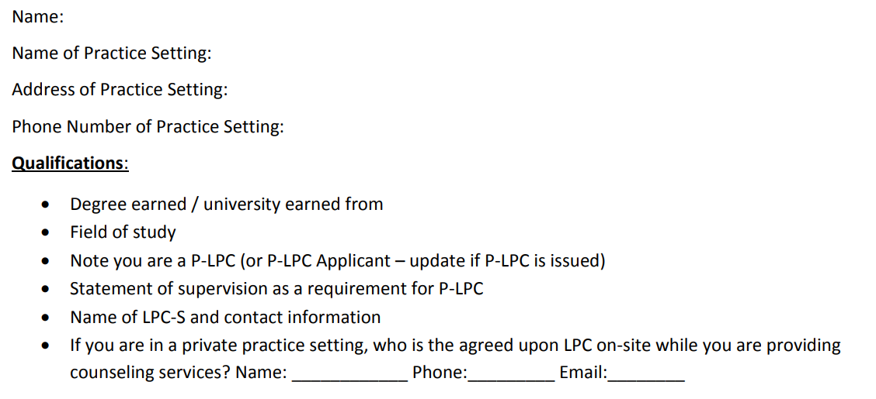
Declaration of Practice
Notes:
Submit Declaration of Practice Statement -- Basically, informed consent for site setting for supervisee
DoP required regardless of setting of practice
For non-governed by settings, location/address and LPC onsite while P-LPC is providing services must be clearly documented.
As Dr. Strebeck just noted in his presentation, if our proposed rules changes are approved, some of this information may change.

Slide 9
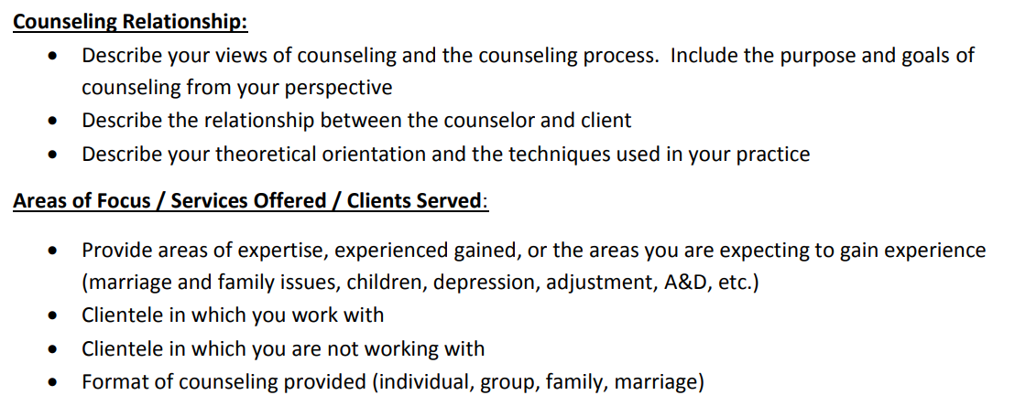
Declaration of Practice

Slide 10
Declaration of Practice

Slide 11
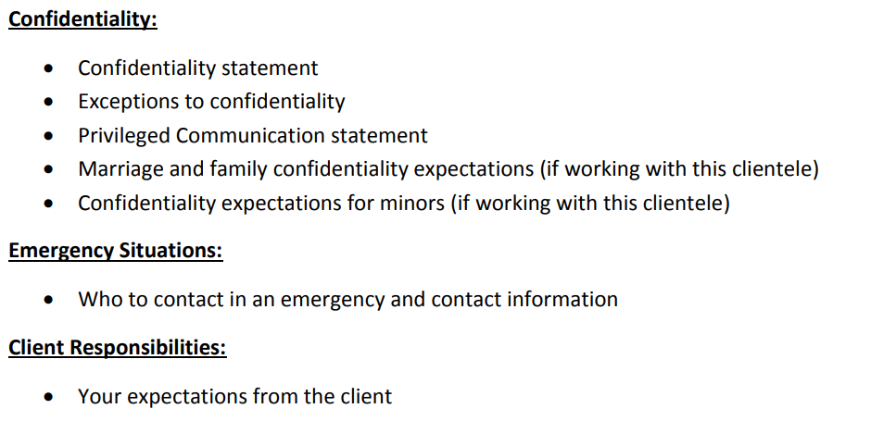
Declaration of Practice

Slide 12
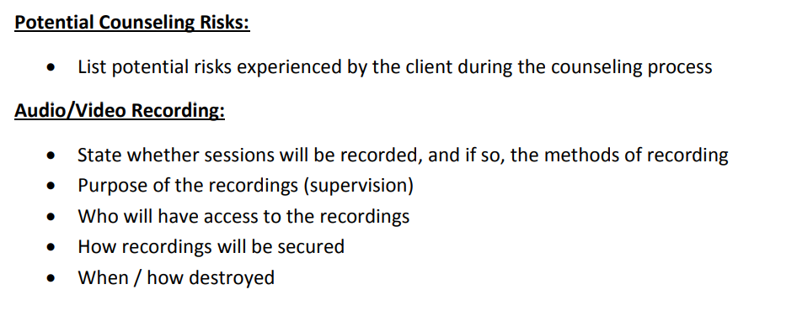
Declaration of Practice

Slide 13
Declaration of Practice
Supervisee will upload to Board’s web portal.
Supervisor will ‘concur’.

Slide 14
Supervisor/Supervision Requirements
The MS Board of Examiners will only approve clinical sites located in Mississippi
A Mississippi LPC-S cannot practice (supervise hours) in another state…….without being appropriately licensed in that state to provide services
A P-LPC may not practice independently or hold oneself out as a counselor in independent practice
Note that a P-LPC must remain under supervision until full licensure is granted (even if supervision hour requirements are completed).
Notes:
A P-LPC cannot practice in a different state for supervision hours unless the P-LPC is licensed in that state---Basically you need to look at counseling and supervision the same. If you cannot counsel then you cannot supervise

Slide 15
Supervisor/Supervision Requirements
The objective of supervision is to develop the supervisee’s clinical skills and competencies and help them be the best counselor and provide the best services to our clients as possible
The supervisor is responsible for assisting the P-LPC/Counselor in:
Developing expertise in methods of professional mental health counseling practice
Developing self-appraisal and professional development strategies
The supervisor is responsible for ongoing evaluation of the supervisee but documented evaluation during renewal
Notes:
Supervisors monitor the performance of an individual by providing regular, documented face-to-face consultation (either one-on-one or in a group face-to-face setting), guidance, and instruction with respect to the clinical skills and competencies of the supervised individual. This makes the supervisor just as responsible for the actions of the supervisee as the supervisee him/herself.
Group is defined as more than 1 but no more than 6 supervisees during one session
Areas of supervision include but are not limited to:
Professional relationships
Supervision roles
Professional ethics
Self-evaluation
Continued professional learning
Etiology and diagnosis
Therapist/client relationship
Oral and written communication

Slide 16
Supervisor/Supervision Requirements
What if I live in a “border” town?
Example: What if I want to practice in Waveland, MS and also get some supervision hours in Slidell, LA.?
As a PLPC, you must follow the Laws and Rules and Regulations for Mississippi and Louisiana
For hours accrued in LA using a MS LPC-S, the supervisor must be licensed in both LA and MS
If the PLPC has a LA supervisor for hours accrued in LA, the MS Board would consider accepting the hours accrued in LA for a MS LPC if the hours were verified by the LA Board

Slide 17
Supervisor/Supervision Requirements
Example:
A PLPC, who has an off-site LPC-S, is renting office space at a private counseling practice where there is an LPC onsite. The PLPC provides their own IC, Intake paperwork, billing, scheduling, practice software, and has ownership of the clients’ records. The PLPC is paid directly from the client or through the billing of insurance. The PLPC has their own business cards with his.her future practice name, but their name is not on the outside door of the practice.
Notes:
Is this person engaging in independent private practice?
What if the PLPC used the office secretary to schedule appointments, the practices Informed Consents, and the practice retained the records of the client? Would this make a difference?
What if the site agreement states that the P-PLC is not an employee of the Practice and there is no employer/employee relationship. The PLPC is simply renting space but supervision is provided
Rule 4.2.B3: Requirements to Become a Provisional-Licensed Professional Counselor (P-LPC)
Supervision Requirements:
In order to receive supervision by an LPC-S a P-LPC may practice in a clinical setting under the supervision of an LPC-S as long as an LPC is available on the premises. In such case, the affiliation between the P-LPC and the on-site LPC must be documented on the Declaration of Practice statement and submitted to the Board. The P-LPC shall neither practice independently nor hold oneself out as a counselor in independent practice.
Rule 4.3.B2: Requirements to Become a Licensed Professional Counselor (LPC)
Supervision Requirements:
In order to receive supervision by a Board qualified supervisor and obtain required experience for licensure, Licensees who have completed the requirements for licensure may practice under the supervision of an LPC-S in a setting where an LPC is immediately available on site. In this situation, an affiliation agreement between the Licensee and the practice shall be submitted to the Board, which indicates the immediate availability of an onsite LPC and that the Licensee shall not practice independently or hold oneself out as a counselor in independent practice.
From a business model this sounds great but think about it from the perspective of the client:
I made an appointment directly with my therapist at his/her counseling company as noted on the business card
I signed the appropriate documents with the counselor’s name and practice on them
I paid the PLPC directly for their services and my session
I made another appointment directly with the PLPC
I asked the PLPC for a copy of my records to be sent to another entity
I call the PLPC directly to cancel my appointment

Slide 18
Distance Professional Services by an LPC-S
Requirements for Service Providers
LPC-S must be a certified telemental health provider by completing one of the following:
Professional Training (Graduate Level Academic Training or Continuing Education Training) containing 9 clock hours which cover the following:
HIPPA compliance for TMH
Ethical and Legal issues (confidentially, privacy issues)
Crisis planning and protocols
Technology
Orienting clients to TMH
TMH settings and care coordination
Appropriateness of the use of TMH
Notes:
Any person providing counseling or supervision services through the means of Distance Professional Services (Telemental Health) must meet the following requirements:
Be an Active Status P-LPC, LPC, or LPC-S in Mississippi.
Hold a license in good standing in the location of the recipient receiving services.
Submit to the Board verification of training (including synchronous or asynchronous audio/video webinars) in TeleMental Health counseling by completing one of the following:
Show completion of the Board Certified-TeleMental Health (BC-TMH) credential from the Center for Credentialing and Education, Inc. (CCE), an affiliate of the National Board of Certified Counselors (NBCC), or an equivalent credential as recognized by CCE.
Professional training. The professional training must be a minimum of nine (9) clock hours. All professional training must include:
HIPAA compliance for Telemental Health
Ethical and legal issues in Telemental Health, including confidentiality/privacy issues
Crisis planning & protocols in Telemental Health
Choosing and using technology in Telemental Health
Orienting clients to Telemental Health
Telemental health settings and care coordination
Appropriateness of Telemental Health
Professional training can be gained by either:
Graduate-Level Academic Training (as documented on the syllabus) or
Continuing Education training course (as documented by certificate).
P-LPCs can practice TeleMental Health counseling with the approval from his/her LPC- S, who must be designated by the Board to be a Distance Professional Services provider.
At the time of license renewal, LPC’s must document 2 hours of continuing education in Telemental Health counseling and P-LPCs must document 1 hour of continuing education in Telemental Health counseling. These continuing education hours are included as part of the required continuing education requirements for renewal.
No licensing fee will be assessed for the Distance Professional Services provider designation.

Slide 19
Distance Professional Services by an LPC-S
BC-TMH credential via the Center for Credentialing and Education (CCE)
Telemental Health credential recognized by CCE
PESI: Telehealth for Mental Health Professionals: 2-Day Distance Therapy Training by Joni Gilbertson via Self-Study material
Only PESI training approved as documented in the May 2020 Board Minutes
** The Board does not endorse any programs to satisfy the professional training requirement.
BC-TMH verification of training must be uploaded to your profile in order to provide these services. The Board will send an email informing of the Board’s approval to provide these services.
Distance supervision provided via synchronous video conferencing only
No telephone, text, email, chat, etc.
These are reserved for only emergency situations
Notes:
PESI is not an Approved Continuing Education Provider (ACEP) through the National Board of Certified Counselors (NBCC)
Board will accept ONLY the following PESI training to satisfy the Continuing Education Training requirement to be designated as a Telemental Health Provider associated with your P-LPC, LPC, or LPC-S.
*** This decision is documented in the Board’s May 15, 2020 minutes (p. 9)
ACA partnered with PESI to provide this training.

Slide 20
Distance Professional Services by a P-LPC
Requirements for Service Providers
P-LPCs must be a Certified-Telemental Health provider by completing one of the same requirements as the LPC-S
P-LPCs can practice TeleMental Health counseling with the approval from his.her LPC-S (who must have the TMH credential)
Remember that an LPC must be onsite even if the P-LPC is providing TeleMental Health Services
Reminder: The Supervision Contract submitted to the Board must include information pertaining to the use and limits of distance supervision, state the qualifications of the LPC-S to provide distance supervision, and document the established procedures for managing the failure of the TMH equipment.
Notes:
Requirements of the PLPC to provide TMH services

Slide 21
Ethical Issues for DPS Providers
Standard of Care: Professionals practice ONLY in areas where their competence has been demonstrated including training, technology, skills and abilities including the use of technology—must understand the workings of the system you choose to use
ACA Code F2C- When using technology in supervision, counselor supervisors are competent in the use of those technologies. Supervisors take the necessary precautions to protect the confidentiality of all information transmitted through any electronic means
Notes:
Your client also needs to know how to operate the technology

Slide 22
Ethical Issues for DPS Providers
Secure internet connections for both parties—network requiring the user to agree to legal terms, register and account and have a password before connecting
HIPAA secured network for both parties (firewalls, antivirus systems, cloud storage)
End to end encryption is an ethical requirement—encryption of data and messaging

Slide 23
Notes:
Your supervisees need to know and practice making ethical decisions and problem solving via real life examples or given scenarios or case studies
Identify the problem—ethical, legal or no problem?
Review the code of ethics for potential violation
Look at the rules and regulations to see if potential violation

Slide 24
Notes:
Determine the nature and dimension of the dilemma by reviewing the Foundational principals
Autonomy
Non-maleficence
Beneficience
Justice
Fidelity
Review the literature
Consult with others
Consult your professional organizations
Consult with an attorney if needed

Slide 25
Notes:
List all possible courses action you can take
List all the potential consequences (positive and negative) of each course of action
Implement and evaluate

Slide 26
Ethical Decision Making
Questions to Ask
Is the action fair?
Would you recommend this action to a peer?
How would you feel if this decision was made public?
Would you want this action to be applied to your family member?
Would others in the field that you respect do the same in this situation?
Are there any lingering feelings of uncertainty, concern, doubt, and uneasiness than what might be considered normal?

Slide 27
Suggestions for Starting Supervision
Review the supervisee’s General Registration information with the supervisee
Review the profile picture to ensure it meets passport requirements and for professionalism
Review degree and degree requirements to ensure Applicant meets qualifications for licensure
Review the Declaration of Practice to ensure it meets the Board’s requirements
Review site where P-LPC will be obtaining hours
Guide the P-LPC or supervisee through the licensure process—know the process of becoming licensed and guide the supervisee through that process
Notes:
DEGREE:
Complete 60 graduate semester hour (or 90 quarter hour) master’s degree which includes the equivalent of 3 semester hours in each of the 12 core course content areas
For degrees conferred after January 1, 2017, the Board will only accept these requirements
Degree must be CACREP or degree programs with the word counseling in its title and meet the 12 content area requirements
90 hour degrees are converted to semester hours by multiplying the number of quarter hours in a specific subject and multiplying it by .67 to get the equivalent semester hour.
For example if someone took 4 quarter hours in Human Growth and Development, that would equate to 2.68 semester hours so the person would not meet the 3 semester hour requirement
Can no longer piece degrees together to make the 60 semester hour requirement or to the add on to make a full 60 degree
OR you can earn a doctoral or educational specialist degree primarily in counseling, guidance, or related field which meets similar standards
12 content areas
HG and D
Social and Cultural Foundations
Counseling / Psychotherapy skills
Group
Lifestyle and Career
Testing and Appraisal
Research and Evaluation
Professional Orientation to Counseling Ethics
Theories of Counseling Psychotherapy and Personality
MFT
Abnormal/Psychopathology
Internship

Slide 28
Notes Regarding Supervision
Supervisor has a responsibility to teach the supervisee and enhance the supervisee’s skills in the areas of
Professional relationships
Professional ethics
Self-evaluation
Professional learning
Etiology and diagnostics
Oral and written communication
Notes:
It is the responsibility of the Supervisor to help the supervisee in any area he or she is struggling with. At the end of the day, the supervisor must feel the supervisee is competent to provide services. There should be no surprises at the end. This is a time for professional growth. If you would not let a family member go to this person for counseling, you should not recommend them for licensure.
I also include in supervision:
Consents and review of consents for TMH, Intakes, Covid Policies, Privacy Policy, Informed Consent, HIPPA policy, Practice Policy regarding billing, appointments, cancellations etc., Release of info form
How to set up your own practice
Ethical decision making

Slide 29
Notes Regarding Supervision
Evaluation of Supervisee:
Individual counseling skills
Group skills
Diagnostic skills
Treatment planning implementation
Recording keeping
Integrity
Consulting skills
Ability to work with others
Ethical behavior
Recognition of limits
Confidentiality
Notes:
P-LPCs must report supervised hours using the Board’s online Supervision Reporting Log
LPC-S must submit an online evaluation of the P-LPC as part of the P-LPCs annual renewal
The P-LPC MUST remain under supervision until the LPC is issued
There is a checkbox that says that the supervisor has discussed the evaluation with the P-LPC
NO SURPRISES

Slide 30
Thank you for your time!
Questions?

